Slide 1
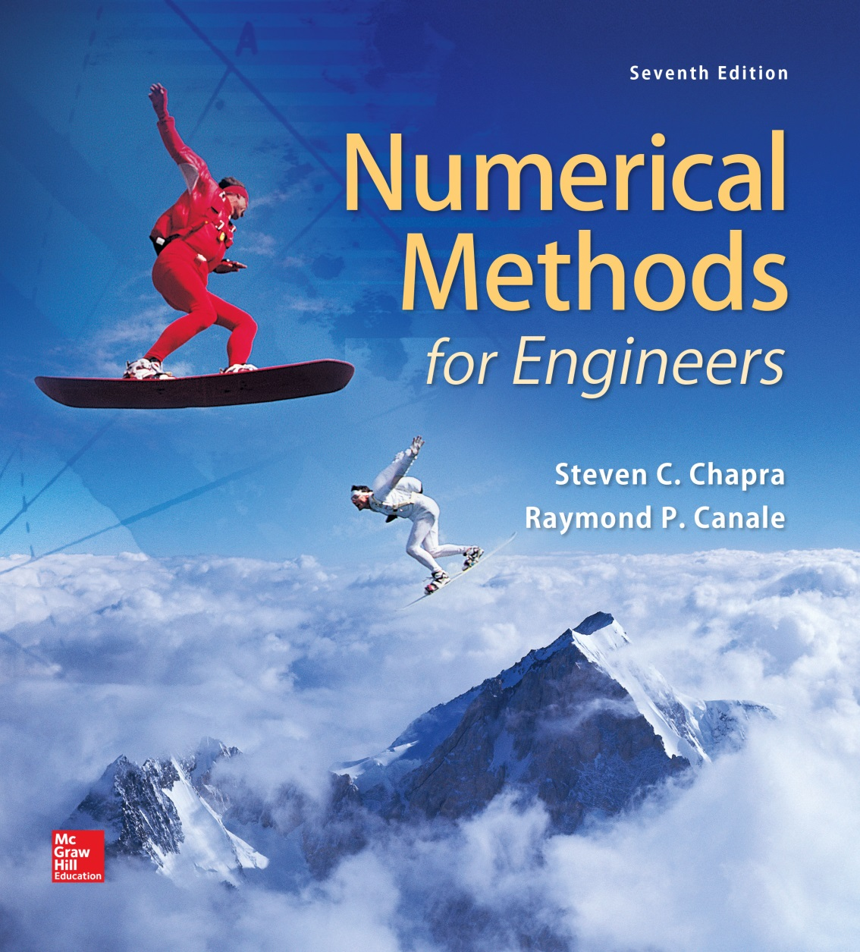
Chapter 15

Slide 2
Constrained Optimization
Chapter 15
LINEAR PROGRAMMING
An optimization approach that deals with meeting a desired objective such as maximizing profit or minimizing cost in presence of constraints such as limited resources
Mathematical functions representing both the objective and the constraints are linear.

Slide 3
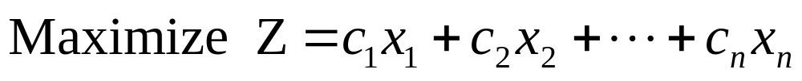
Standard Form/
Basic linear programming problem consists of two major parts:
  The objective function
  A set of constraints
For maximization problem, the objective function is generally expressed as
c_{j}= payoff of each unit of the jth activity that is undertaken
x_{j}= magnitude of the jth activity
Z= total payoff due to the total number of activities

Slide 4
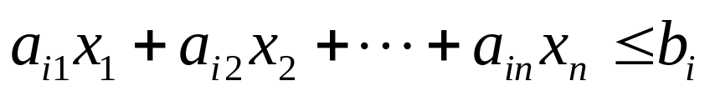
The constraints can be represented generally as
Where a_{ij}=amount of the ith resource that is consumed for each unit of the jth activity and b_{i}=amount of the ith resource that is available
The general second type of constraint specifies that all activities must have a positive value, x_{i}>0 .
Together, the objective function and the constraints specify the linear programming problem.

Slide 5
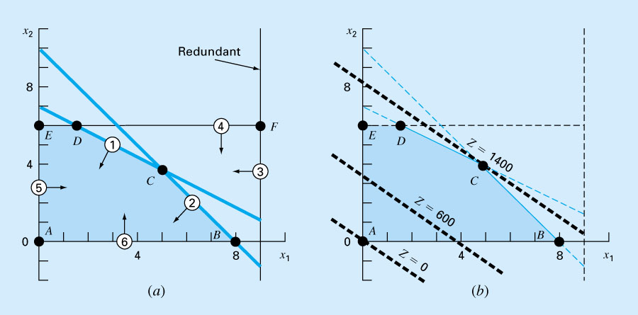
Figure 15.1

Slide 6
Possible outcomes that can be generally obtained in a linear programming problem/
Unique solution. The maximum objective function intersects a single point.
Alternate solutions. Problem has an infinite number of optima corresponding to a line segment.
No feasible solution.
Unbounded problems. Problem is under-constrained and therefore open-ended.

Slide 7
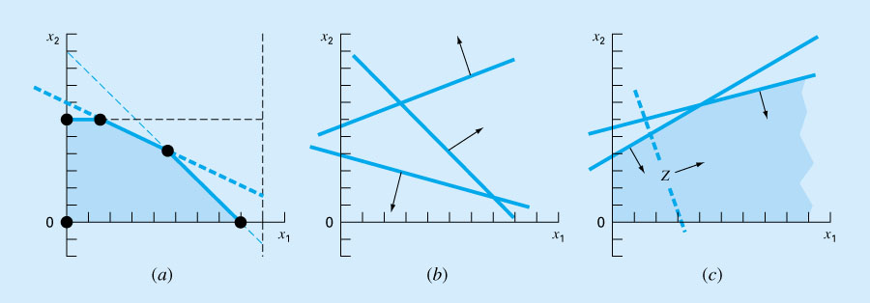
Figure 15.2

Slide 8
The Simplex Method/
Assumes that the optimal solution will be an extreme point.
The approach must discern whether during problem solution an extreme point occurs.
To do this, the constraint equations are reformulated as equalities by introducing slack variables.

Slide 9
A slack variable measures how much of a constrained resource is available, e.g.,
7x₁+ 11 x₂ ≤ 77
If we define a slack variable S₁ as the amount of raw gas that is not used for a particular production level (x₁, x₂) and add it to the left side of the constraint, it makes the relationship exact.
7x₁+ 11 x₂ + S₁ = 77
If slack variable is positive, it means that we have some slack that is we have some surplus that is not being used.
If it is negative, it tells us that we have exceeded the constraint.
If it is zero, we have exactly met the constraint. We have used up all the allowable resource.

Slide 10
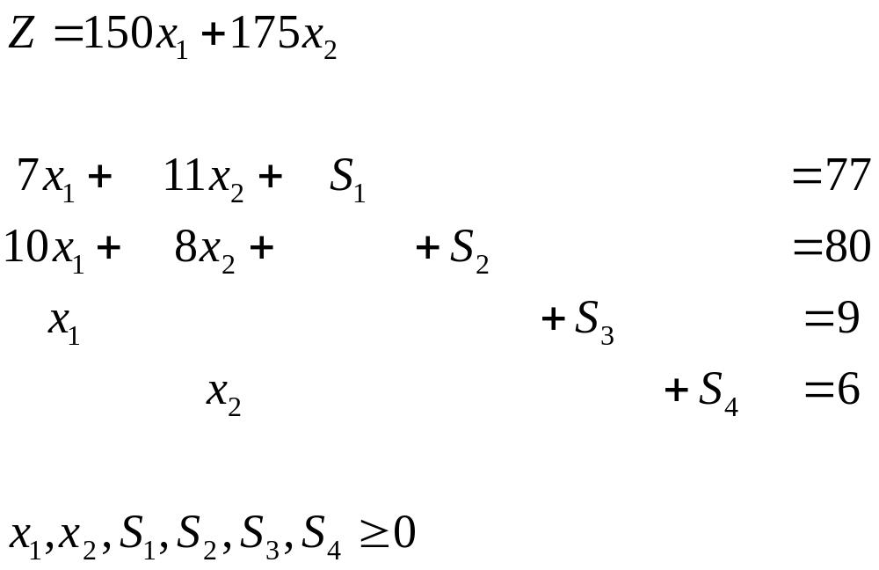
Maximize

Slide 11
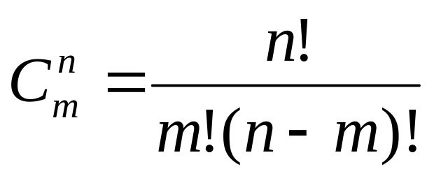
We now have a system of linear algebraic equations.
For even moderately sized problems, the approach can involve solving a great number of equations. For m equations and n unknowns, the number of simultaneous equations to be solved are:

Slide 12
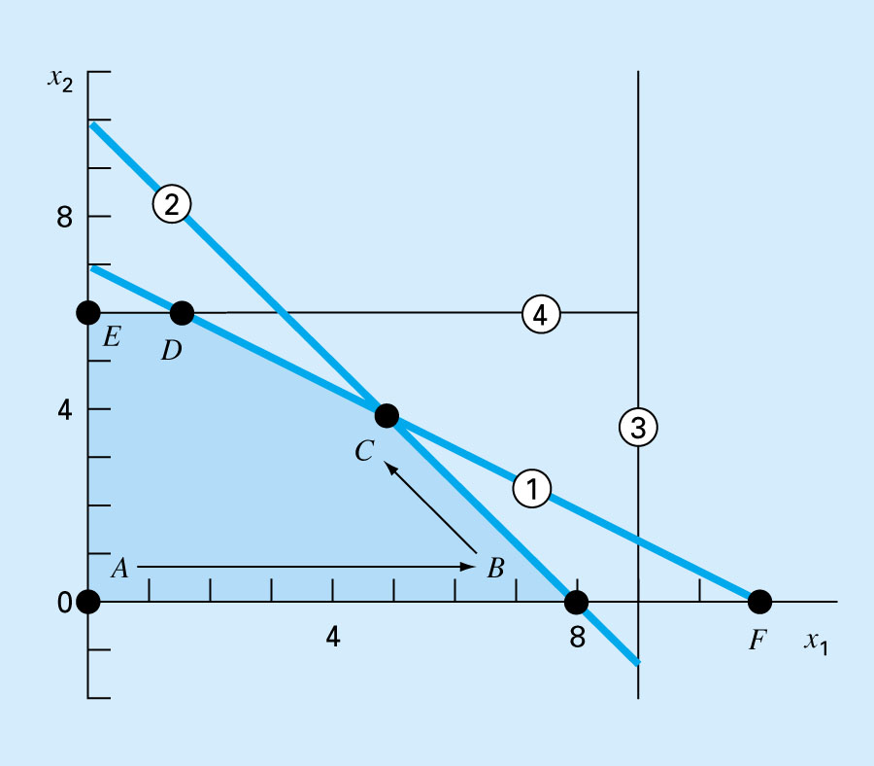
Figure 15.3

